Slide 1
Content
Solving nonlinear differential equation with differentiable quantum circuits
Cat qubit

Slide 2
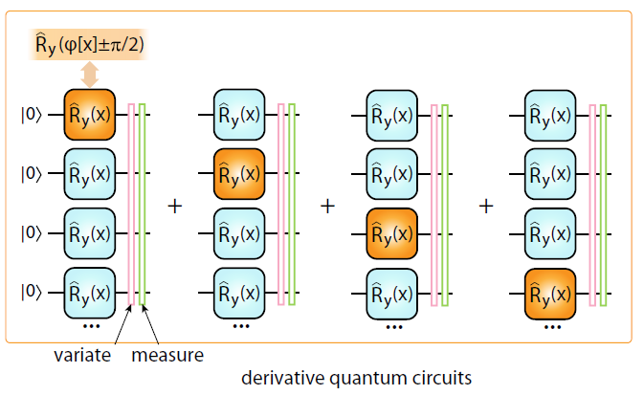
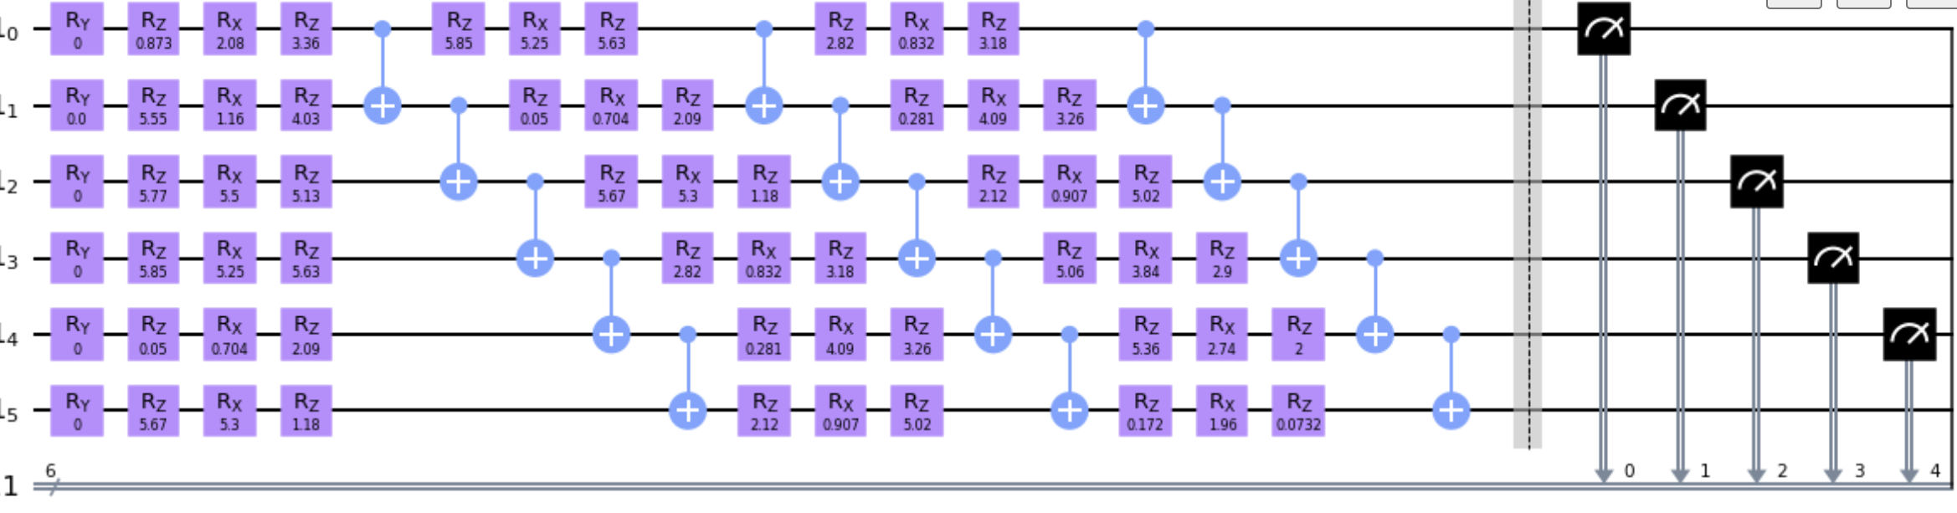
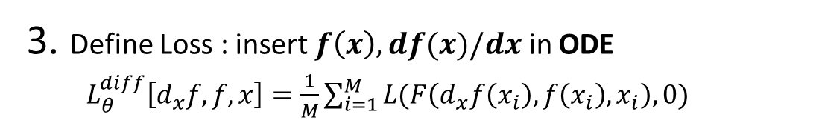
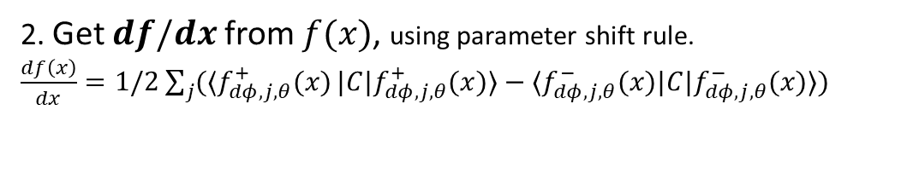
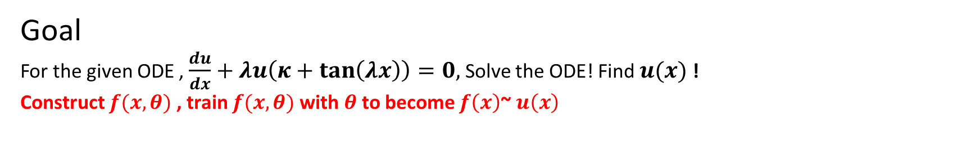


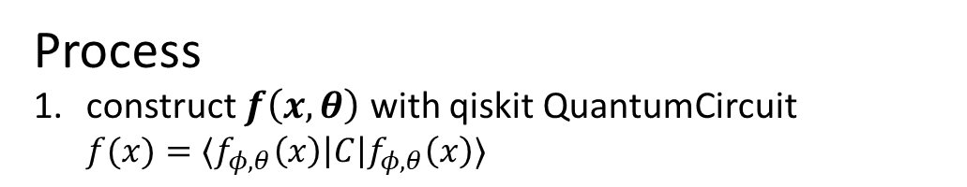
Goal
For the given ODE , $\frac{du}{dx}+λu\left(κ+\tan\left(λx\right)\right)=0,$ Solve the ODE! Find $u(x)$ !
Construct $f(x,θ)$ , train $f(x,θ)$ with $θ$to become $f\left(x\right)$~ $u\left(x\right)$
Process
construct $f\left(x,θ\right)$ with qiskit QuantumCircuit $f(x)=⟨f_{φ,θ}\left(x\right)\left|C\right|f_{φ,θ}\left(x\right)⟩$
2. Get $df/dx$ from $f(x)$, using parameter shift rule. $\frac{df\left(x\right)}{dx}=1/2\sum_{j}{(⟨f_{dφ,j,θ}^{+}(x)}|C|f_{dφ,j,θ}^{+}(x)⟩−⟨f_{dφ,j,θ}^{−}(x)|C|f_{dφ,j,θ}^{−}(x)⟩)$
Recycling $f(x)$!
IBM
simulator
Circuit expectation
Featuremap(x)
Depth 3 parametrized Ansatz($θ$)
Measure
3. Define Loss : insert $f\left(x\right),df(x)/dx$ in ODE $L_{θ}^{diff}\left[d_{x}f, f, x\right]=\frac{1}{M}\sum_{i=1}^{M}{L(F\left(d_{x}f\left(x_{i}\right), f\left(x_{i}\right), x_{i}\right),0)}$
4. minimize(Loss)
2021 ,PRA, Kyriienko et al

Slide 3
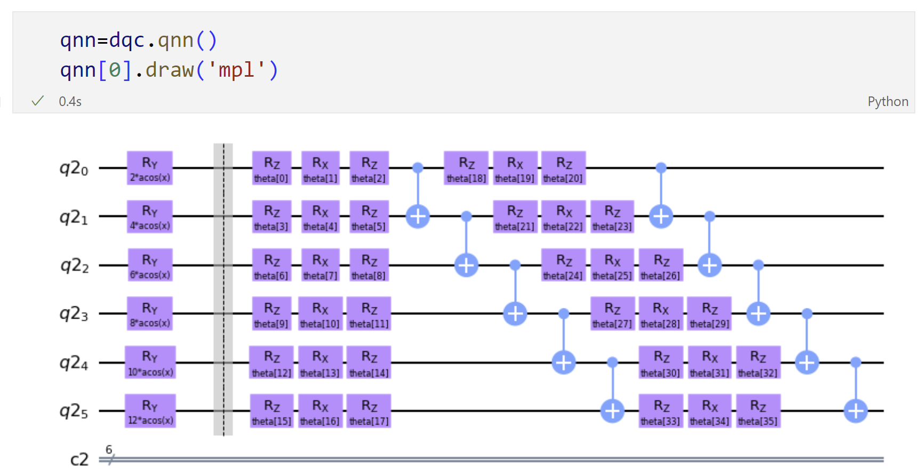

Slide 4
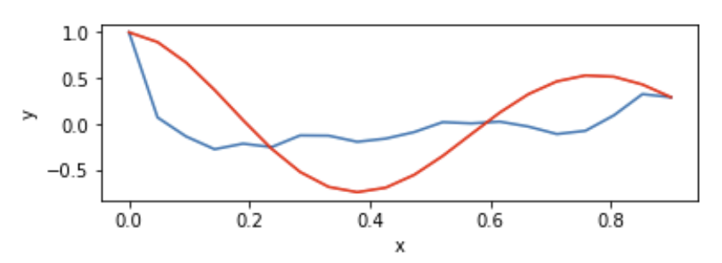
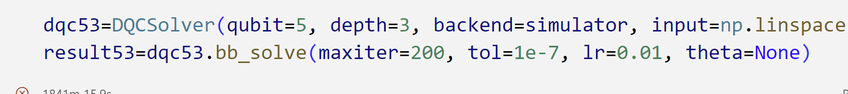
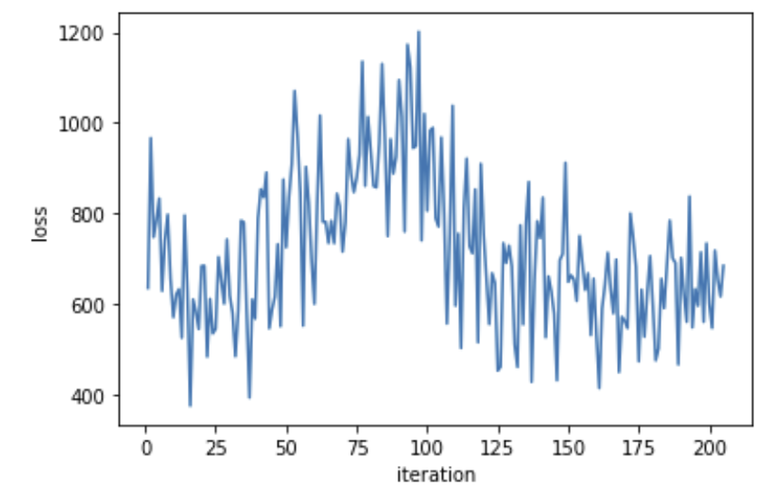

Slide 5
